Slide 1


A Belgium
Translator
The program allows users to select a total of five languages, including English, French, Dutch, German and Korean, which are commonly used in Belgium,
and automatically translates the text into the language of their choice when they input text from all over the world.
The program will also be registered in a Chrome extension program.
And i can change the main screen language
Presented by Geun Woo Kim

Slide 2

Table of Contents
01
Title
04
Technical Overview
02
Core Features
05
Code Highlight
03
How It Works

Slide 3

01.
Title
A Belgium Translator
Description: A Chrome extension that automatically translates text from any language into a specified language among Korean, English, French, Dutch, and German.
Technology: Built as a Chrome extension using HTML, CSS, and JavaScript.

Slide 4
02.
Core Features
Simple and Effective Translation
Language Selection: Users can choose a target language from a dropdown menu, including Korean, English, Dutch, French, and German
Text Input: A text area allows users to enter the text they want to translate.
Automatic Detection: The extension automatically detects the source language of the text entered by the user.
Instant Translation: A single button click triggers the translation process and displays the result instantly.

Slide 5
03.
How it Works
The User Flow
Open Popup: The user clicks the extension icon to open the popup window.
Enter Text: The user types or pastes text into the provided text area.
Select Language: The user selects a target language from the dropdown menu.
Translate: The user clicks the "Translate" button.
Fetch Translation: The popup.js script constructs a Google Translate URL and sends a request to the service.
play Result: The translated text is received as a JSON response and is displayed in the output area of the popup.

Slide 6
04.
Technical Overview
The Engine Behind the Extension
manifest.json: This file serves as the blueprint for the extension, defining its name, version, description, and the popup file.
popup.html: This is the user interface of the extension, containing the text input area, language selection, and translation result display.
popup.js: This JavaScript file handles the core logic. It listens for user actions, fetches the translation from the Google Translate API via a URL, and updates the UI with the result.
popup.css: This file styles the user interface to ensure a clean and functional layout.

Slide 7
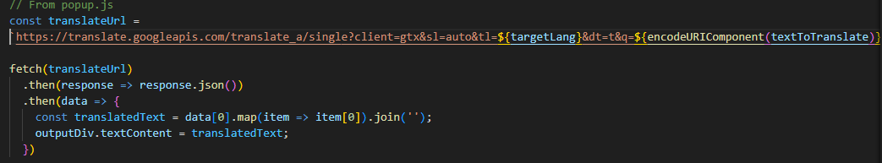
05.
Code Hilight
The Translation Logic
How it works :
A URL is built dynamically with the user's text (textToTranslate) and selected language (targetLang)
The fetch() function sends an asynchronous request to the Google Translate API.
The response, a JSON object, is parsed to extract the translated text, which is then displayed in the output div.

Slide 8
Thank You
Thank you for watching my PPTX. I hope everyone doesn't have any language difficulties

